Slide 1
Displacement – Data, Trends & Solutions
Preconference Seminar
September 16, 2024

Slide 2
Why are we here today?
1:00 – 1:40 Elements of Displacement
1:40 – 1:50 Breakout
1:50 – 2:00 Report Out
2:00 – 2:40 Measuring Displacement
2:40 – 2:50 Breakout
2:50 – 3:00 Report Out
3:00 – 3:40 Policy Solutions
3:40 – 3:50 Breakout
3:50 – 4:00 Report Out

Slide 3
Elements of Displacement

Slide 4
Why are we here today?
2 uncomfortable questions
5 lessons on displacement
1 thing we can do about it

Slide 5




Why is displacement bad?
Improve dropout rates by 30%
Reduce crime by 20%
Increase employment rates by 20%
Improve health by 18%
Notes:
Asking why displacement is bad, is like asking why stability is good. With stability we can see increases in education, safety, employment and overall health. With displacement we get instability which results in bad outcomes for education, safety, employment and overall health.

Slide 6
How do we address displacement?
  Talking with residents for years
Bring you in on that conversation
Discussing and creating common definitions
Developing a menu of policy options
Be an accomplice to residents for policy change

Slide 7

Creating common definition
DIVESTMENT
ABANDONMENT
DISPLACEMENT
GENTRIFICATION
GROWTH
POLICY
SEGREGATION
RACIAL EQUITY
Notes:
We have been reviewing the research on displacement over the last few months and we have identified that nationally, there are some areas of consensus, and then there is a vast debate on terminology, causes, and solutions. Our first goal here this morning is to figure out how we as an alliance are going to define these terms and causes. Later today, and for several months after we will continue to discuss solutions. You will notice boards across the room with these 8 terms. You will also notice post-it notes on your tables. In lieu of taking notes for yourself, we are asking to share your notes with others. All of todays materials, including this presentation, is already available on our website, and we are recording todays presentations.

Slide 8
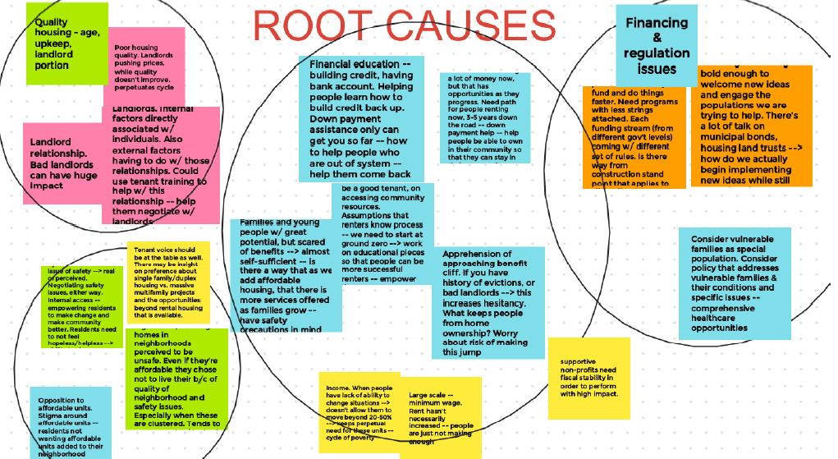


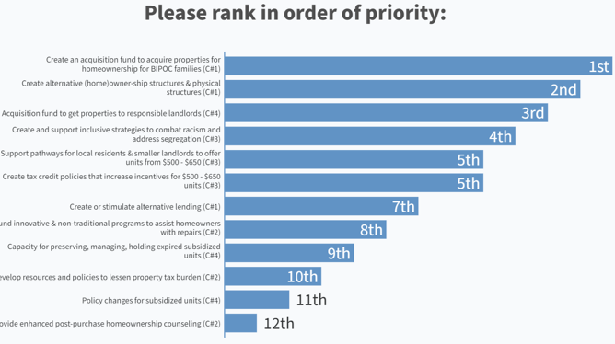

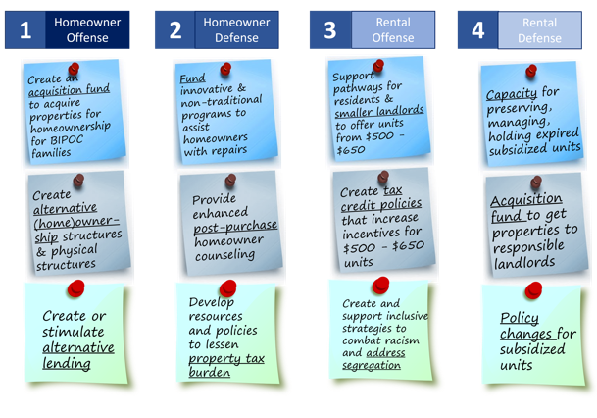

Collective Objectives
Grow homebuyer counseling & down payment assistance (DPA)
Acquisition Fund to combat predatory acquisition
Vacant Lots to 1st Generation Homes
Alternative lending based on rental history and 40 – 60% DTI
Notes:
So now let’s get to these two uncomfortable questions and how we came about them. In order to do that, we need to discuss what our understanding as staff of the alliance was about how displacement worked at the beginning of the year, and where we are now. Here are our collective objectives that were set by reviewing resident plans, continuous collaboration with residents, and countless surveys and conversations with all of you and hundreds of others. We are having tremendous success in each of these areas, supporting over 1,500 new homeowners, but obviously still a lot of work left to do. Let’s take the vacant lots to 1st generation homes example to highlight our early understanding of displacement and what we are doing to mitigate it.

Slide 9



Early understanding of displacement
Homes priced around $120K
Resident Preference
Deed restricted with lower assessment
Target monthly payment below rent
$120k
$120k
Renter
Cohorts of existing residents in coaching
Notes:
When we build an entry level home, we have been aware of

Slide 10

Emerging understanding of displacement
$400k
$120k
Renter
Unhoused
Drawing on the examples provided in Robinson, Nicole, PhD "Recidivism Among Black Men Living in Racialized and Carceral Neighborhoods and the Role of Gentriﬁcation" (2022). Theses and Dissertations. 2935.
Notes:
The recent conversation around the zoning changes in Growing MKE kind of blew our mind. How could a zoning change that nationally has shown to contribute to more inventory, expand housing choice, and decrease displacement; a zoning change recommended by dozens of racial equity organizations; how could this policy tool be seen as a tool of gentrification? So like with most issues we decided to listen, do our research, and what we found raises two very uncomfortable questions that we need your help in resolving. A huge shout out to Metcalfe Park who elevated the work of Dr. Nicole Robinson, a UWM researcher; and for Dr. Robinson’s comments herself at the City Plan Commission. We encourage you to read Dr. Robinson’s dissertation which is linked in this presentation. We hope to partner with Dr. Robinson in the future for a more detailed training, but for now, here is an example we created inspired by her work to explain the two uncomfortable questions. It is important to understand this example in the context of a mass incarceration state. I once looked it up. When I was a teenager, the number of people in state prisons was about 5,000 people. It is now over 25,000 people. As a current example, Wisconsin has roughly the same population and crime demographics as Minnesota, yet we imprison 2.5 times more people. Consequently, because we are in a mass incarceration state, our housing strategies need to be more conscious about the impacts they may have on police interactions. So here’s the example. If a $400,000 home is built in a vulnerable neighborhood, then that $400,000 is likely going to be the first to call the police on an unhoused person experiencing a mental health crisis. This causes a police encounter that can end up in reincarceration, or worse. This $400,000 home owner is likely also likely going to call the police on the renters in the neighborhood playing music that they don’t like, causing a police interaction that could lead to a police record, or worse. Finally, this $400,000 homeowner is likely to complain about the upkeep of the $120,000 homeowner who doesn’t have the same means to upkeep or improve the home. This can lead to a code violation or other scrutiny leading to a feeling that the existing homeowners are not welcome in their own neighborhood. I’ll never forget the mother in my own neighborhood that was in tears when new neighbors sent a letter that her lawn care was impacting their home values.

Slide 11
Uncomfortable Questions
$120k
$120k
Renter
Unhoused
Notes:
I think we all generally understand the principle of the $400,000 homeowner in the vulnerable neighborhood; but here comes the first uncomfortable question. Is a new $120,000 homeowner, contributing to the displacement of other residents? That new $120,000 homeowner is unlikely to complain about the other $120,000 homeowner, but may be just as likely to call the police on the unhoused person, or the renters with music they don’t like. Sometimes we even glamorize this phenomena by using terms like “more eyes on the street,” “broken windows theory,” or the general concept of more homeownership reduces crime. But there is a difference between reducing crime by providing more housing stability for vulnerable people, and reducing crime by replacing it elsewhere; especially when that elsewhere is often the state prison system.

Slide 12
Uncomfortable Questions
2 uncomfortable questions
Uncomfortable Question #1
Is a new $120,000 homeowner, even if home is deed restricted, contributing to the displacement of other residents?
Uncomfortable Question #2
Unrelated to our projects, displacement is transpiring. What is CDA's role in addressing that displacement?
Notes:
So uncomfortable question #1 - Is a new $120,000 homeowner, even if home is deed restricted, contributing to the displacement of other residents? – then obviously we need to confront that. But there is a second uncomfortable question. Displacement caused by others is a real risk to our strategies to increase Black and Latino homeownership because those that may be displacing people are fighting for the same public resources and land that we are. Let me offer a few quick examples. In the midtown area, with allies we are building 80 new homeownership opportunities at $120,000 each, and 40 rental units for less than $1,000 per month. Research tells us that these are effective anti-displacement tools. However, just blocks away there are homes receiving public money and public land to build $400,000 homes. It is difficult for residents to know which is which, so a fear of all new construction develops, that its not for our friends and families, but for someone else. Or a development that may displace people may use the same financial tools, like a Tax Incremental District (or TID), and now residents don’t know which TIDs are used for displacement and which are for them, so all TIDs become bad. There are also some big opportunities coming down the pipeline, like what will happen when Highway 175 comes down, or with the Northridge land; or the scar of the Parkwest freeway that was never built. Will this land be used to attract higher income homeowners to increase the tax base, be used to restore attainable homeownership opportunities for Black & Latino families, or both? So, uncomfortable question #2 is – Does our alliance have an obligation to combat displacement caused by others?

Slide 13
Emerging Understanding of displacement
5 lessons on displacement
Displacement harms all of us.
Climate, Policy & Economy impact displacement
Early elements hard to see
Not just homeowners
Displacement is not inevitable
Notes:
Before we answer either of these questions, we need to be on the same page about displacement event means and what might even cause it. One thing we can say for sure is that displacement is super complicated. This presentation has lots of links for people that want to dive into the complexity. Many of you got a taste of that yesterday, but for today’s purposes, we wanted to share 5 lessons we have learned about displacement. Again, we expect you to agree with some of this, disagree with others. Which is why we want to hear from you, remember those post-it notes.

Slide 14



1. Displacement harms all of us
Devastating impacts on the people displaced.
Cities with unequal development and higher segregation have less prosperity for everyone
Commute times and cost of public transit increase
Loss of social networks of safety, childcare and eldercare increases can never be replaced with public services
See Levy, Diane. Community-level Effects of Displacement (Urban Institute 2006); and Kern, Leslie, Gentrification is Inevitable and Other Lies (2022).

Slide 15
2. Climate, Policy & Economy impact Displacement
Climate
Policy
Economy
Drawing on the information presented in the Bittle, Jake, The Great Displacement: Climate Change and the next American Migration (2023)

Slide 16


2. Climate, Policy & Economy impact Displacement
Climate
Dangerous climates directly displace people
Attractive climates, attract people, displacing existing people

Slide 17


2. Climate, Policy & Economy impact Displacement
Policy
Over regulation restricts inventory of housing, displacing people
Under regulation favors investors, causing displacement

Slide 18
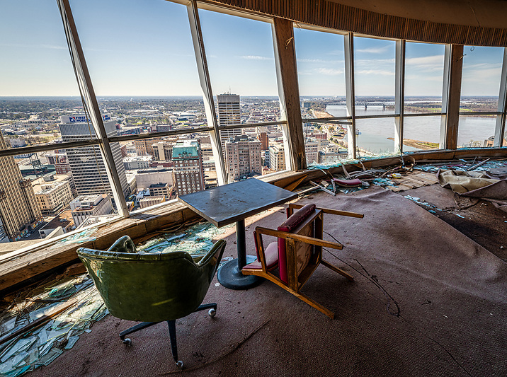
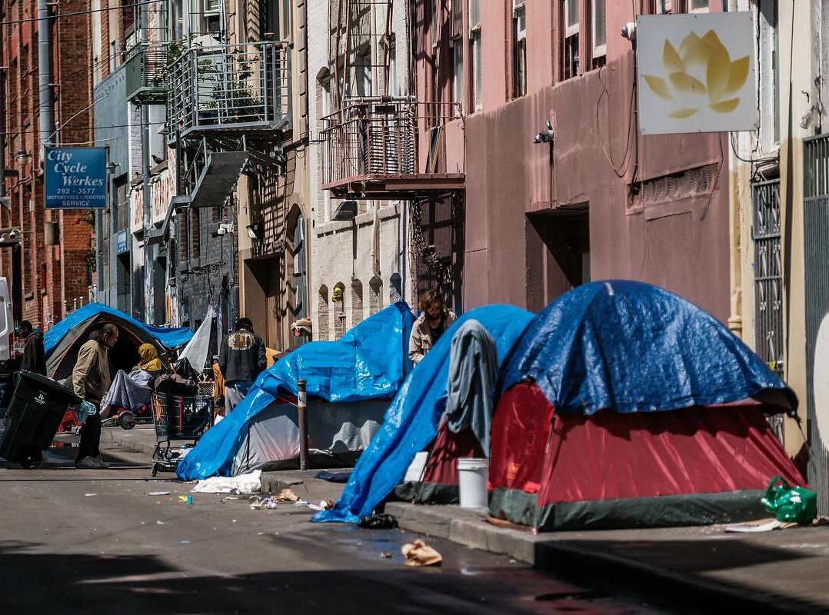
2. Climate, Policy & Economy impact Displacement
Economy
Negative growth means less opportunity, displacing people
Too much growth means too expensive, displacing people
Photo Credit: artofabandonment.com (left), San Francisco Chronicle (right)

Slide 19

2. Climate, Policy & Economy impact Displacement
Climate
Policy
Economy

Slide 20
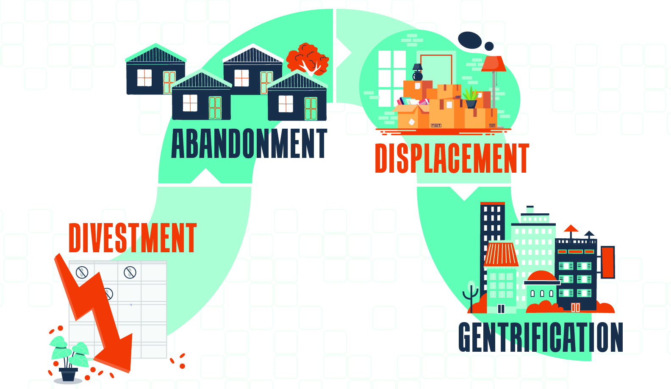
3. Early elements hard to see
Drawing on the definition provided in Phillips, M., Smith, D., Brooking, H., & Duer, M. (2021). Re-placing displacement in gentriﬁcation studies: Temporality and multi-dimensionality in rural gentriﬁcation displacement. Geoforum, 118, 66–82. (citied by Robinson, Nicole, PhD "Recidivism Among Black Men Living in Racialized and Carceral Neighborhoods and the Role of Gentriﬁcation" (2022). Theses and Dissertations. 2935.)

Slide 21
4. Not just homeowners
$400k
$120k
Renter
Unhoused

Slide 22
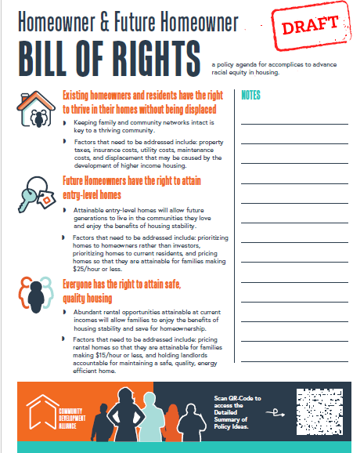
5. Displacement is not inevitable
1 thing we can do about it
Be an accomplice to residents for policy change

Slide 23
Next Steps for tomorrow
10:30 – 10:45 Wellness Break
10:45 – 11:30 Gallery Walk. Part of working together is creating common definitions, with a recognition that all terms are nuanced. Participants will rotate through dight gallery stations to express their perspective on core terms
11:30– 11:45 Grab Lunch
11:45 – 12:15 What options might be on the Menu? Overview of potential policy options that could be included in a Homeowner & Future Homeowner Bill of Rights.
12:15 – 1:00 Developing the Menu. Exercise to develop what participants believe should be in a Homeowner & Future Homeowner Bill of Rights.
1:00 – 1:45 Alliance Panel. Reflections on the days discussion will be highlighted by representatives of each sector of the alliance: residents, neighborhood organizations, implementors, policy organizations, philanthropy, and public/private funders.
1:45 – 2:00 Closing. Ex Fabula Storytellers, RACH, and CDA Staff will close the event with next steps on prioritizing and implementing a Homeowner & Future Homeowner Bill of Rights.

Slide 24
Questions
What is your perspective on the two uncomfortable questions?
What do you think of the 5 Lessons of Displacement? Is it what you expected? Are there others you think should be included?

Slide 25
Measuring Displacement

Slide 26
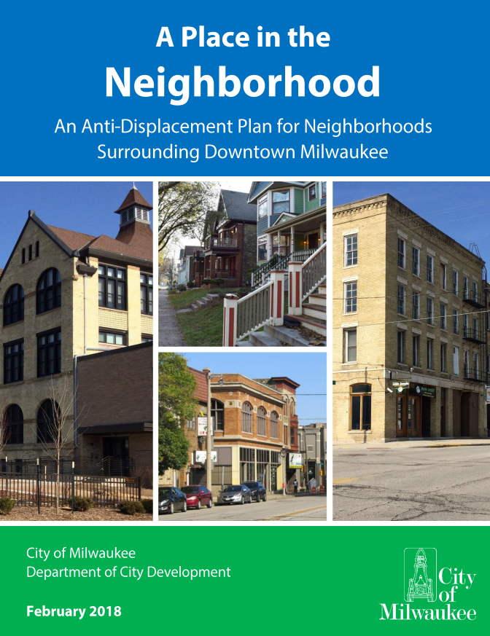
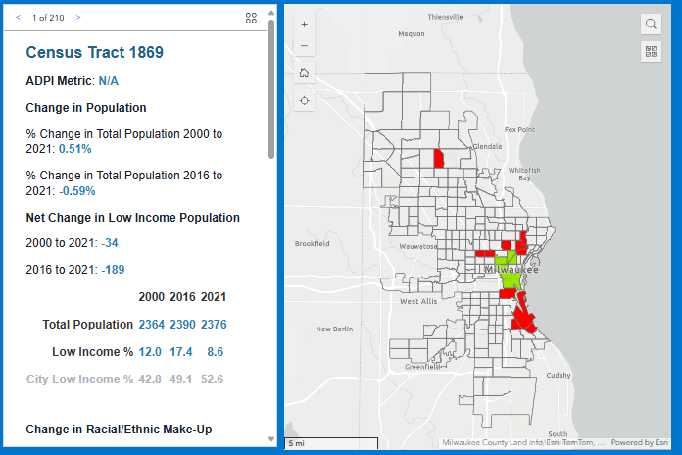
Where we are at now

Slide 27
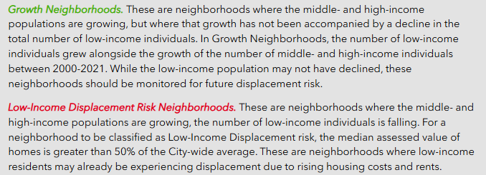
Where we are at now

Slide 28
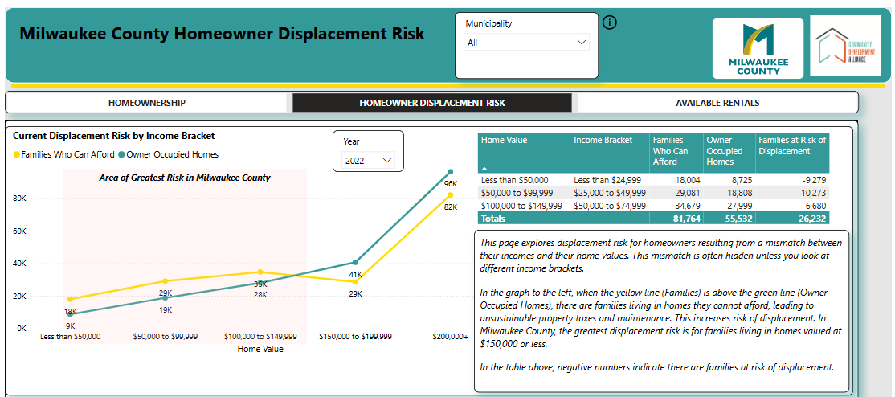
Where we are at now

Slide 29
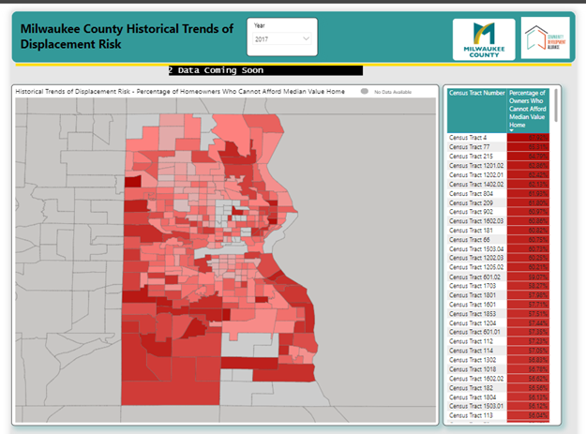
Where we are stuck

Slide 30
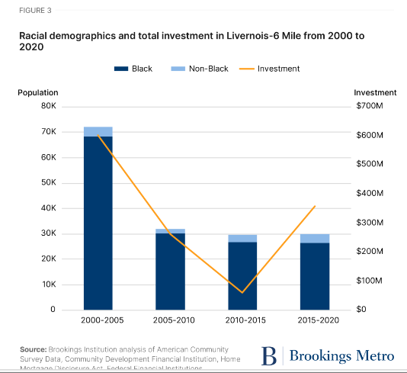
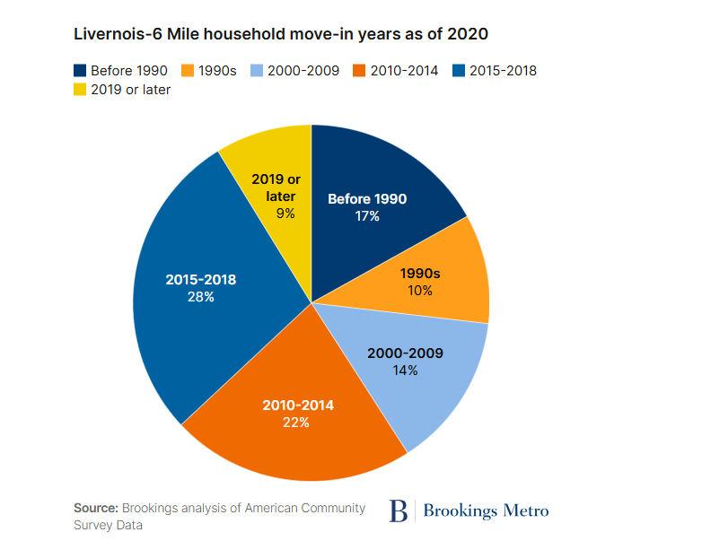
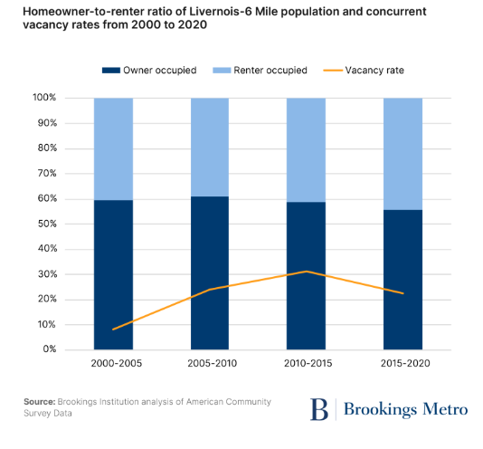
How others measure
Race & Income
Homeownership Rate & Vacancy
Legacy Residents

Slide 31
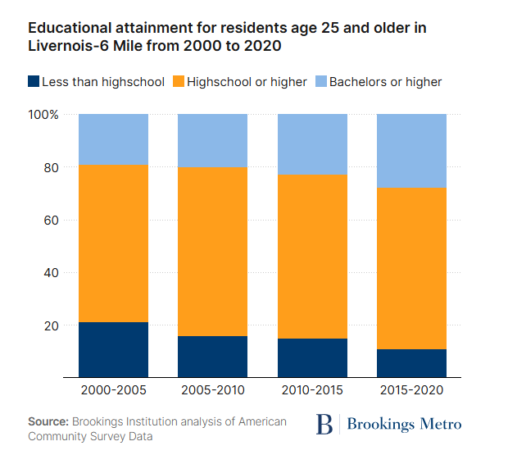
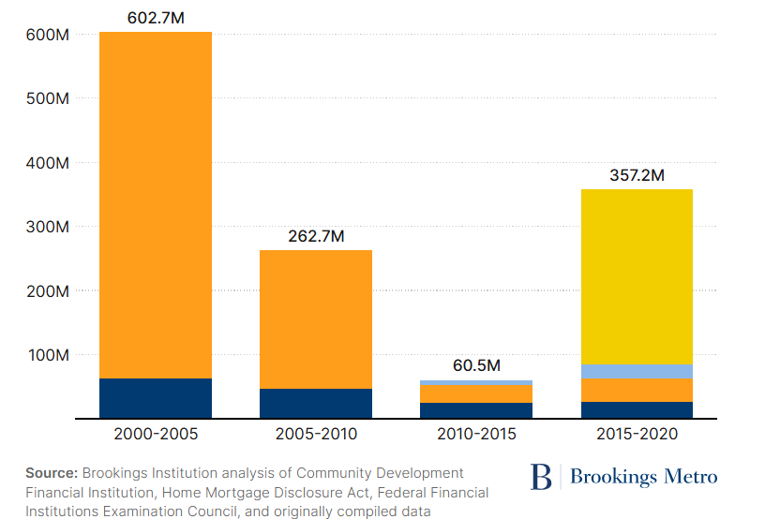
How others measure
Investment
Educational Attainment

Slide 32
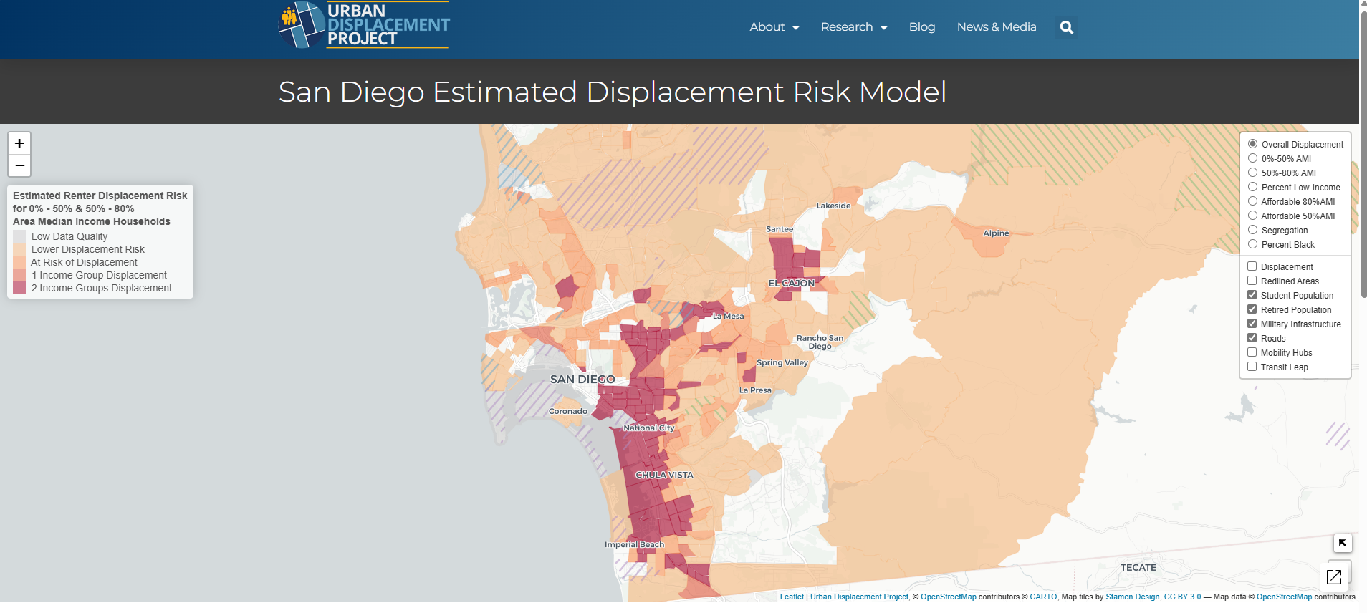
How others measure
Using an algorithm with consumer data and census data to estimate risk.

Slide 33
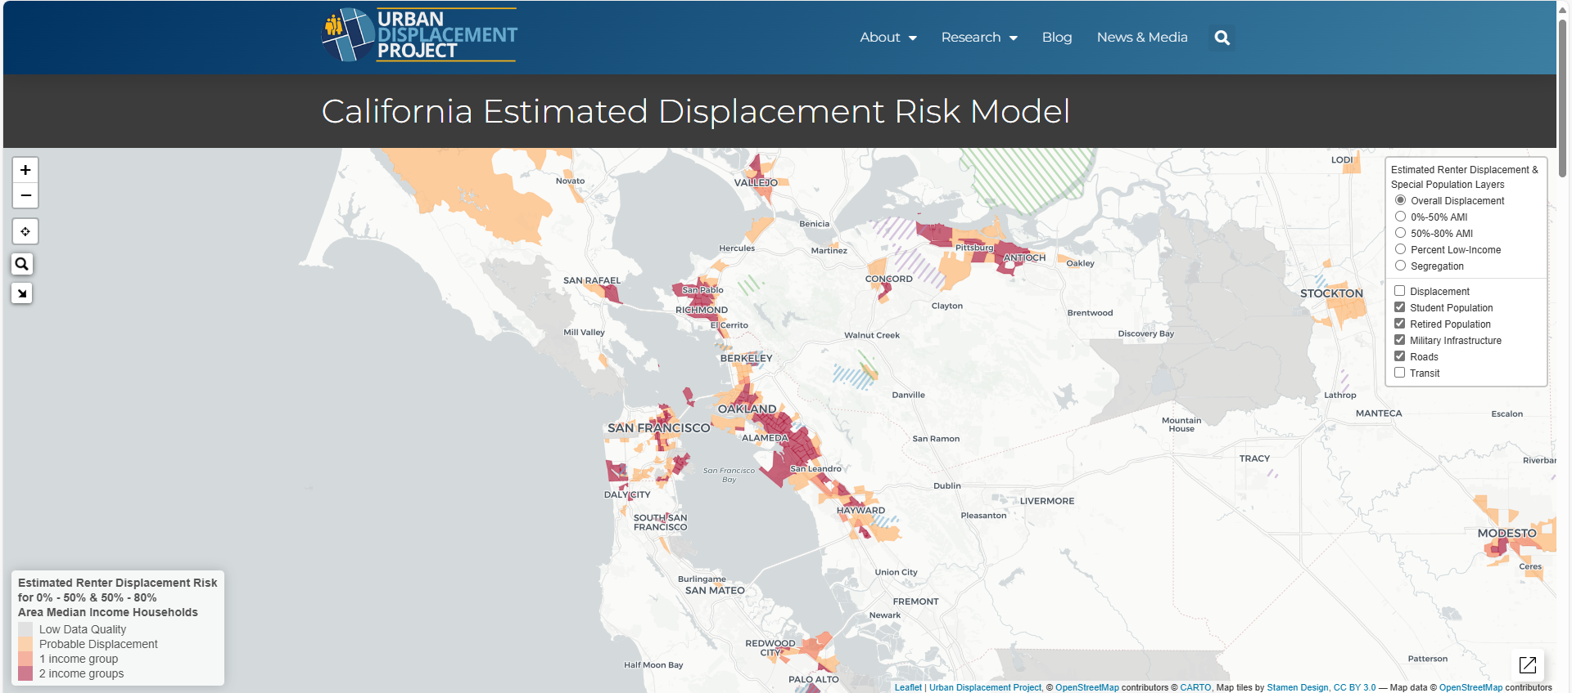
How others measure
Measuring displacement by income groups

Slide 34
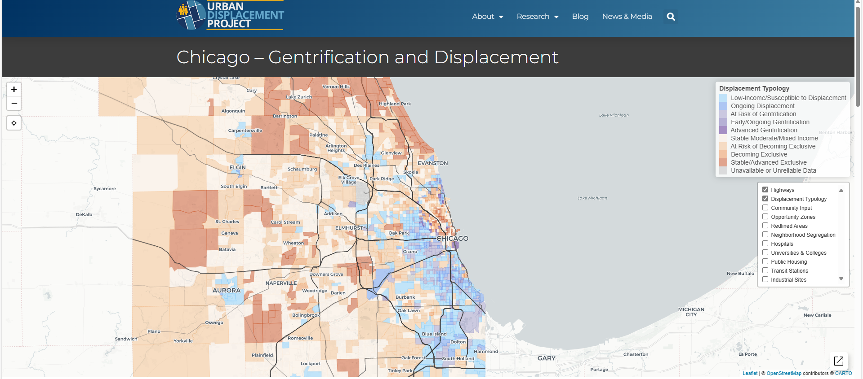
How others measure
Measuring stages of displacement

Slide 35
How others measure
Measuring stages of displacement

Slide 36
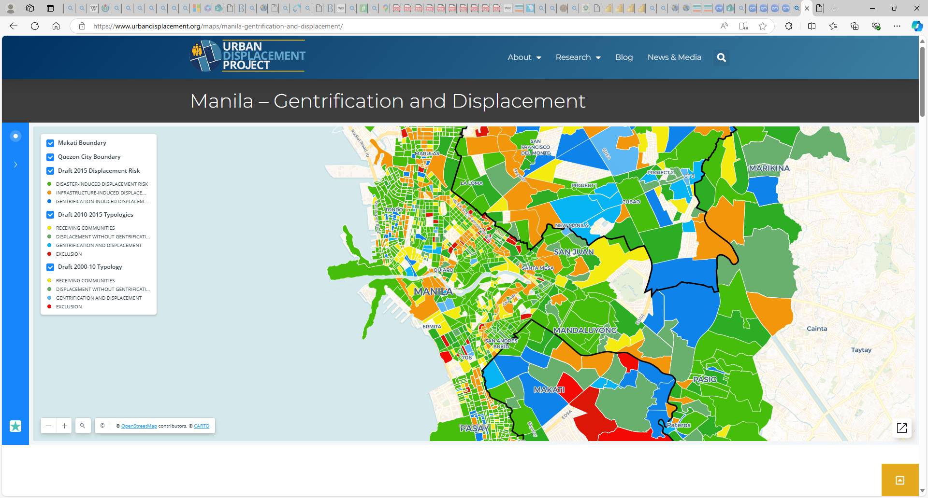
How others measure

Slide 37
A Potential Way to Measure
Use HMDA/SBA and if % is substantially less than regional average, then neighborhood is in abandonment.
AND/OR
Use MPROP Data and Census vacancy data, and if % is less than average, neighborhood is in abandonment.
Use MPROP to measure length of abandonment
Use census data to look at loss of overall population by race, income band and legacy residents.
Use HMDA & SBA data to identify if home and business loans are going down in an area. If the rate is going down less than regional average, neighborhood is in divestment.
Use census data to look at race, education, income, home value

Slide 38
If we know stage, we can intervene
Provide support to homeowners
Build new/rehab subsidized homeownership
Eviction Protection
Provide support to homeowners
Build new/rehab subsidized homeownership
Tenant Opportunity to Purchase
Increase public investment into infrastructure for existing residents (e.g. replace lead laterals)
Special loan and DPA products
Provide subsidized rental
Land Trust Homes

Slide 39
Questions
What would be the dream state for being able to measure displacement risk and actual displacement in Milwaukee?
What is the next best step that would provide the most value?

Slide 40
What options might be on the menu?

Slide 41
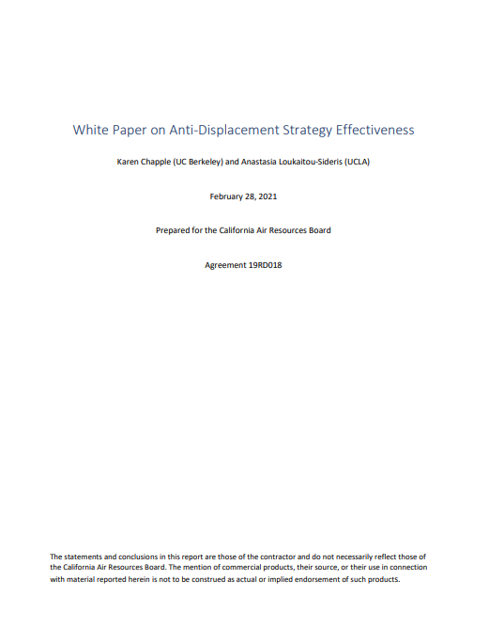
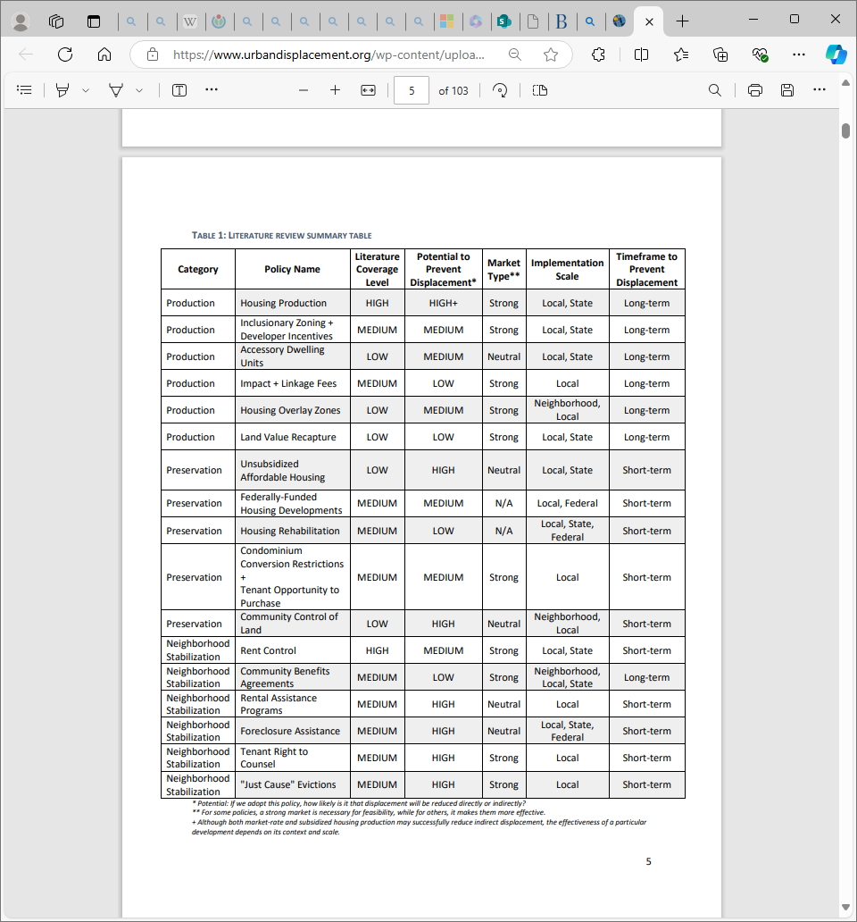

5 Important Studies
Recidivism Among Black Men Living in Racialized and Carceral Neighborhoods and the Role of Gentrification (Dr. Nicole Robinson, 2022)
Redress Policy Toolbox - The Redress Movement
Policy – Urban Displacement
Shifting Neighborhoods: Gentrification and Cultural Displacement in American Cities » NCRC
Investment without displacement: How a surge of development changed—and didn’t change—one Detroit neighborhood | Brookings

Slide 42
5 Important Studies
Recidivism Among Black Men Living in Racialized and Carceral Neighborhoods and the Role of Gentrification (Dr. Nicole Robinson, 2022)
Redress Policy Toolbox - The Redress Movement
Policy – Urban Displacement
Shifting Neighborhoods: Gentrification and Cultural Displacement in American Cities » NCRC
Investment without displacement: How a surge of development changed—and didn’t change—one Detroit neighborhood | Brookings

Slide 43
5 Important Studies
Recidivism Among Black Men Living in Racialized and Carceral Neighborhoods and the Role of Gentrification (Dr. Nicole Robinson, 2022)
Redress Policy Toolbox - The Redress Movement
Policy – Urban Displacement
Shifting Neighborhoods: Gentrification and Cultural Displacement in American Cities » NCRC
Investment without displacement: How a surge of development changed—and didn’t change—one Detroit neighborhood | Brookings

Slide 44
5 Important Studies
Recidivism Among Black Men Living in Racialized and Carceral Neighborhoods and the Role of Gentrification (Dr. Nicole Robinson, 2022)
Redress Policy Toolbox - The Redress Movement
Policy – Urban Displacement
Shifting Neighborhoods: Gentrification and Cultural Displacement in American Cities » NCRC
Investment without displacement: How a surge of development changed—and didn’t change—one Detroit neighborhood | Brookings

Slide 45
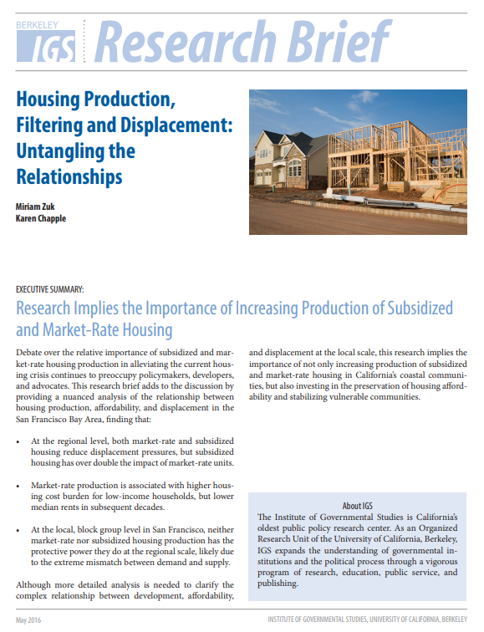
5 Important Studies
“. . . we found that both market-rate and subsidized housing development can reduce displacement pressures, but subsidized housing is twice as effective as market-rate development at the regional level.”
Recidivism Among Black Men Living in Racialized and Carceral Neighborhoods and the Role of Gentrification (Dr. Nicole Robinson, 2022)
Redress Policy Toolbox - The Redress Movement
Policy – Urban Displacement
Shifting Neighborhoods: Gentrification and Cultural Displacement in American Cities » NCRC
Investment without displacement: How a surge of development changed—and didn’t change—one Detroit neighborhood | Brookings

Slide 46
3 Important Studies
“Market-rate production is associated with higher housing cost burden for low-income households, but lower median rents in subsequent decades.”
Recidivism Among Black Men Living in Racialized and Carceral Neighborhoods and the Role of Gentrification (Dr. Nicole Robinson, 2022)
Redress Policy Toolbox - The Redress Movement
Policy – Urban Displacement
Shifting Neighborhoods: Gentrification and Cultural Displacement in American Cities » NCRC
Investment without displacement: How a surge of development changed—and didn’t change—one Detroit neighborhood | Brookings

Slide 47
5 Important Studies
“… because market mechanisms work differently at different geographic scales, market-rate construction can simultaneously alleviate housing pressures across the region while also exacerbating them at the neighborhood level.”
Recidivism Among Black Men Living in Racialized and Carceral Neighborhoods and the Role of Gentrification (Dr. Nicole Robinson, 2022)
Redress Policy Toolbox - The Redress Movement
Policy – Urban Displacement
Shifting Neighborhoods: Gentrification and Cultural Displacement in American Cities » NCRC
Investment without displacement: How a surge of development changed—and didn’t change—one Detroit neighborhood | Brookings

Slide 48
5 Important Studies
“… because market mechanisms work differently at different geographic scales, market-rate construction can simultaneously alleviate housing pressures across the region while also exacerbating them at the neighborhood level.”
Recidivism Among Black Men Living in Racialized and Carceral Neighborhoods and the Role of Gentrification (Dr. Nicole Robinson, 2022)
Redress Policy Toolbox - The Redress Movement
Policy – Urban Displacement
Shifting Neighborhoods: Gentrification and Cultural Displacement in American Cities » NCRC
Investment without displacement: How a surge of development changed—and didn’t change—one Detroit neighborhood | Brookings

Slide 49
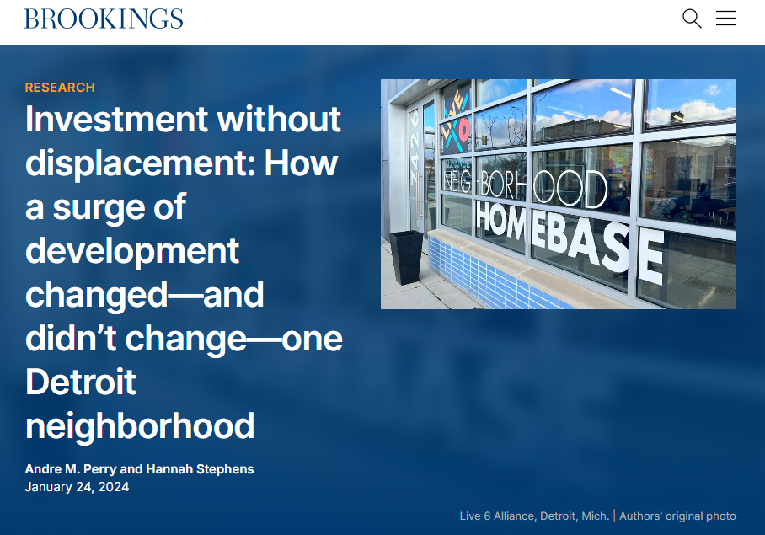
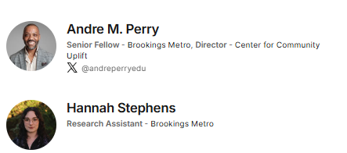
5 Important Studies
“Our analysis did not find investment-induced displacement in Livernois-6 Mile; rather, the largest displacement was due to the loss of investment between 2005 and 2015. The area remained overwhelmingly Black, with no significant spikes in median income.”
Recidivism Among Black Men Living in Racialized and Carceral Neighborhoods and the Role of Gentrification (Dr. Nicole Robinson, 2022)
Redress Policy Toolbox - The Redress Movement
Policy – Urban Displacement
Shifting Neighborhoods: Gentrification and Cultural Displacement in American Cities » NCRC
Investment without displacement: How a surge of development changed—and didn’t change—one Detroit neighborhood | Brookings

Slide 50
5 Important Studies
To pursue that intentionality and center people in investment in Livernois-6 Mile and beyond, we recommend:
Creating educational and employment opportunities with local postsecondary institutions.
Including long-standing community organizations in the investment planning process.
Investing in affordable housing and homeownership.
Paying attention to neighborhood dynamics and protecting legacy residents.
Recidivism Among Black Men Living in Racialized and Carceral Neighborhoods and the Role of Gentrification (Dr. Nicole Robinson, 2022)
Redress Policy Toolbox - The Redress Movement
Policy – Urban Displacement
Shifting Neighborhoods: Gentrification and Cultural Displacement in American Cities » NCRC
Investment without displacement: How a surge of development changed—and didn’t change—one Detroit neighborhood | Brookings

Slide 51
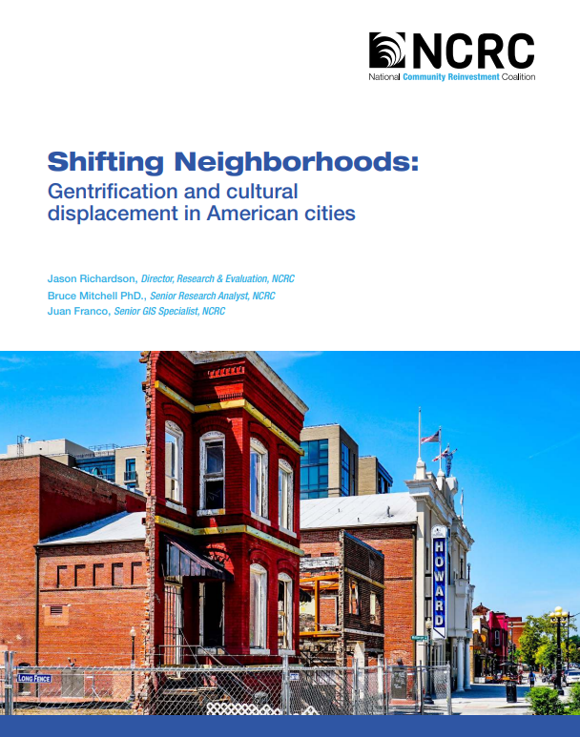
5 Important Studies
This study found that from 2000 through 2013 the following occurred:
Gentrification and displacement of long-time residents was most intense in the nation’s biggest cities, and rare in most other places.
Gentrification was concentrated in larger cities with vibrant economies, but also appeared in smaller cities where it often impacted areas with the most amenities near central business districts.
Most low- to moderate-income neighborhoods did not gentrify or revitalize during the period of our study. They remained impoverished, untouched by investments and building booms that occurred in major cities, and vulnerable to future gentrification and displacement.
The strict tests for gentrification and displacement in this study and the limitations of the data available likely undercounted instances of gentrification and displacement.
Recidivism Among Black Men Living in Racialized and Carceral Neighborhoods and the Role of Gentrification (Dr. Nicole Robinson, 2022)
Redress Policy Toolbox - The Redress Movement
Policy – Urban Displacement
Shifting Neighborhoods: Gentrification and Cultural Displacement in American Cities » NCRC
Investment without displacement: How a surge of development changed—and didn’t change—one Detroit neighborhood | Brookings

Slide 52
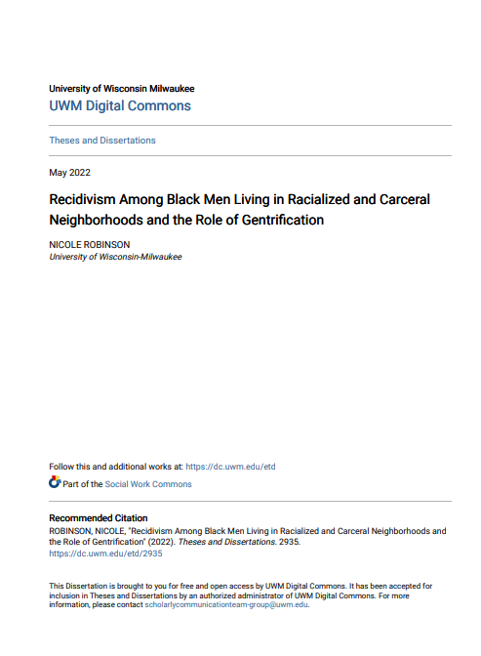
5 Important Studies
“One of the place-based themes that emerged from these interviews was gentrification, which was identified and associated with the built environment of the local neighborhood (e.g., city-owned property, exclusionary housing market), the political economy within the larger city and region (e.g., redevelopment of downtown, fresh water sources), and the role of mass incarceration in contributing to demographic shifts amenable to gentrification processes.”
Recidivism Among Black Men Living in Racialized and Carceral Neighborhoods and the Role of Gentrification (Dr. Nicole Robinson, 2022)
Redress Policy Toolbox - The Redress Movement
Policy – Urban Displacement
Shifting Neighborhoods: Gentrification and Cultural Displacement in American Cities » NCRC
Investment without displacement: How a surge of development changed—and didn’t change—one Detroit neighborhood | Brookings

Slide 53
5 Important Studies
Neighborhoods experiencing abandonment, low-income concentration, and low-income displacement did not have a higher risk of recidivism compared to neighborhoods that were not experiencing any demographic shifts.
Neighborhoods experiencing overall growth, that is, where the population was increasing overall, with both upper-income and low-income populations increasing, had higher odds of recidivating.
Using another measurement of gentrification, no significant association between gentrification and recidivism was found

Slide 54

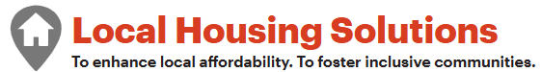

Tools for Policy Development

Slide 55
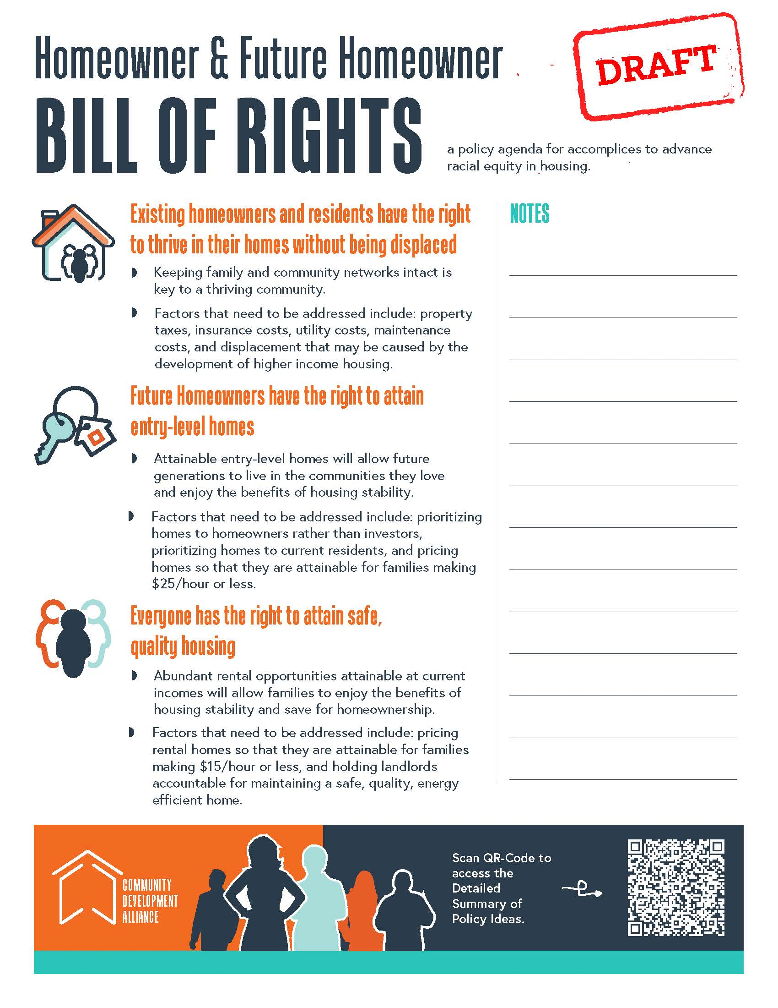
What could be on the menu?
Example: a tax-exemption for low-income seniors

Slide 56
Building the menu
Property tax increases will not dispace homeowners
Policy Needed | Path to Adoption | Status | Pros | Cons | Notes
Homestead tax rate for fixed income seniors | Requires change to Uniformity Clause in State Consititution | TBD | less displacement for low income seniors | higher property tax burden for non-low income seniors | Homestead exemption
Homestead tax exemption for low-income seniors | Adding exemptin to exsting state law (similar to universities and manufacturing) | TBD | less displacement for low income seniors | higher property tax burden for non-low income seniors | Legal analysis needed to ensure can be done by state statue.
Property taxes based on date of purchase | Requires change to Uniformity Clause in State Constitution | Not active | benefits long-term owners on a fixed income | chilling of sales, would require income restriction to be equitable | Requires analysis
Property taxes based on income | Requires change to Uniformity Clause in State Consititution | Not active | equitable taxation | administrative cost | Requires analysis
Land Value Tax | Requires change to Uniformity Clause in State Consititution | Not active | benefits homeowners |  | The Land Value Tax Plan | City of Detroit (detroitmi.gov)
Resources for Land Trusts for subsidized homeownership | Increasing public budget for landtrusts | Some funds in City Budget, County Taskforce | Forever affordable homes | Cost resources
Resources for Opt-in Landtrust for vulnerable homeowners | Funding to MCLT for existing homeowners | Not active | Less displacement for vulnerable homeowners | Less home equity for vulnerable people

Slide 57
What could be on the menu?
Example: a Tenant Opportunity to Purchase (TOPA)

Slide 58
Building the menu
Future Homeowners have the right to attain entry-level homes
Why is this Important: If future generations do not have attainable stable housing, those that can leave our community will leave, those who cannot leave will experience housing instability and the related damaging consequences.
Future homeowners will have a priority over investors
Policy Needed | Path to Adoption | Status | Pros | Cons | Notes
Tenant Opportunity to Purchase Act (TOPA) for Single-family and duplex | Local Ordinance | CDA prepared to move forward with support | more inventory for homeowners | adminstrative cost
Landlords licensed and accountable for disruptions to neighbors | Change in statute that restricts local control of landlords | not active | landlord accountability | administrative cost, potential chilling of new rental units.
Regulating short term rentals | City Ordinance for less than 7 days | not active | More inventory | Less return for investors | The Redress Movement
Limit predatory advertising and do not call list | Local Ordinance | CDA prepared to move forward with support | less predatory investing | enforcement cost, potential chilling of new rental units
Wholesaler license and cooling off period | Need Legal opinion | not active | More inventory | Could chill sales | Need Legal opinion, see https://redressmovement.org/transitioning-gentrifying/
Anti-Speculation fees for vacant and abandoned property | Requires change to Uniformity Clause in State Consititution | Not active | More inventory | Could chill sales | See Georgia
Vacant Lot registry | Need Legal opinion | Not active | More inventory | Admin cost | Inclusionary, Low Opportunity - The Redress Movement
Limiting short-term rentals of homeowner inventory | City Ordinance, but may require state law change | not active | less distruption in neighborhoods | Less return for investors | Needs legal analysis
Landlords licensed and accountable for maintaining to homeownership standards | Change in statute XXX that restricts local control of landlrods | not active | landlord accountability | administrative cost, potential chilling of new rental units.

Slide 59
What could be on the menu?
Example: a Tenant Opportunity to Purchase (TOPA)

Slide 60
Building the menu
Rents will be lowered until rents are sustainable for families making $15/hour or less
Policy Needed | Path to Adoption | Status | Pros | Cons | Notes
Zoning policy to increase inventory to lower costs | Growing MKE allows for the increase in high demand neighborhoods. | File introduced on 7/15/24. If adopted, 6 month process to update zoning code. | additional inventory | NIMBYism in high demand areas. | XXX - American Planning association recommendation
Rent control for vulnerable housing stock | Change in state law that prohibits rent control | not active | stabalized rents | less inventory | See NHLC vs. Policy Link
Inclusionary Zoning | Change in state law that prohibits inclusionary zoning | not active | higher % affordable | less overall inventory
Extending subsidized housing to be forever affordable | QAP change for forever affordable, not just 30 years, potential federal change | not active | more rental units saved | potential chilling of new LIHTC units | Need review if federal or state requirement
Prioritizing famlies that make less than $15/hour | Changes to QAP | not active | higher % affordable | less overall inventory
Amend workforce housing bill to prioritize rental for famlies making $15/hour | Change to state law | not active | more equitable rental units | less resources for higher incomes

Slide 61
Questions
Look at the factors under each clause of the Homeowner and Future Homeowner Bill of Rights, anything you would highlight or add?
Is there a dream policy idea you have to address any of the clauses?

